Slide 1
SICP CASE STUDY
BOOK INVENTORY SYSTEM

Slide 2
GROUP 16
CB.EN.U4CSE17014 | CH. SAI PAHNI JASWANTH
CB.EN.U4CSE17043 | NANDITHA MENON
CB.EN.U4CSE17049 | RISHI VIGNESH
CB.EN.U4CSE17065 | T. SAI SRIHITHA REDDY

Slide 3
PROBLEM STATEMENT
Assume that a local bookstore (that sells story books) has contacted you to provide an inventory system (which is a collection of information related to all the books) for their book website. Since you wanted to try your hand in functional programming paradigm, you chose to implement the inventory system in Racket.

Slide 4
REQUIREMENTS
Abstract book - name, price
Finding a book in the inventory
Number in stock, number of copies sold
Find fast selling and worst selling genres
Find fast selling and worst selling authors

Slide 5
DATA STRUCTURES

Slide 6
book(title, (author, genre, price, noInStock, noSold))
Title - title of the book
Author- author of the book
Genre - genre of the book
Price - Price of the book
noInStock - number of books in stock under a given title
noSold - number of book sold under a given title

Slide 7
inventory(list of book nodes)
This data structure contains the list of books
Each element in the list is a node of the data structure ‘book’
genre-count(genre,count)
Each element in this data structure has 2 fields: genre, count
Gives the number of books sold in each genre
author-count(author,count)
Each element in this data structure has 2 fields: author, count
Gives the number of books sold under each author

Slide 8
“inventory” stores each book in the format of [title, (author, genre, price, noInStock, noSold)]
“author-count” stores each author available in the bookstore and the respective count of books sold in the format of [author, count]
“genre-count” , similar to author-count, stores each genre available in the bookstore and the respective count of books sold in the format of [genre, count]

Slide 9
PROCEDURES

Slide 10
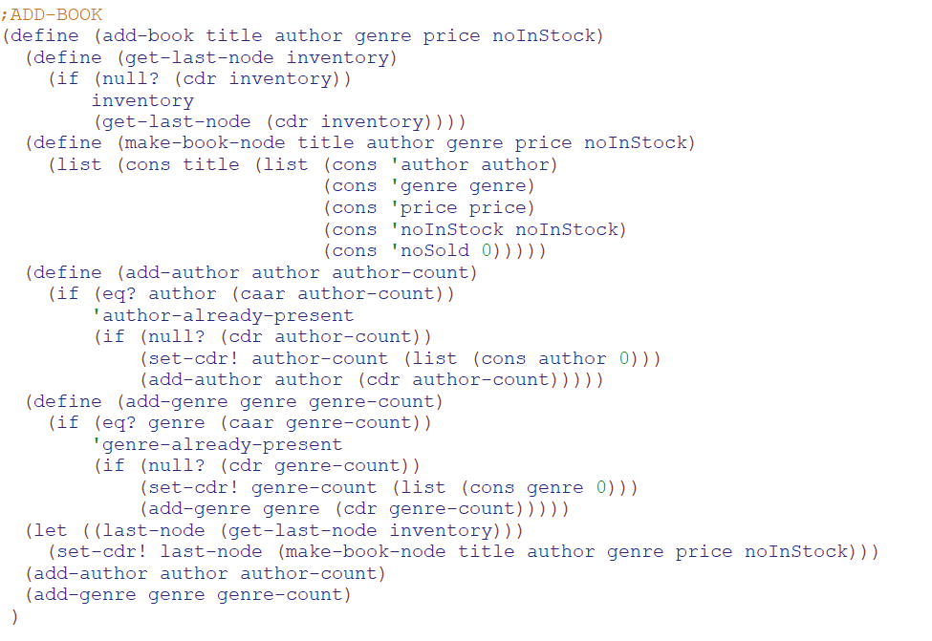
ADD-BOOK
CB.EN.U4CSE17043

Slide 11
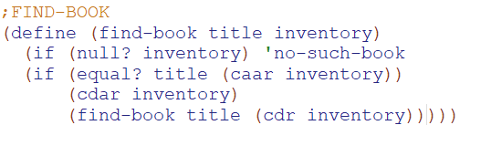
2. FIND-BOOK
CB.EN.U4CSE17049

Slide 12
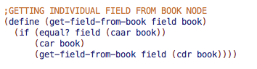
3. GET-FIELD-FROM-BOOK
CB.EN.U4CSE17065

Slide 13

4. GET-STOCK-COUNT OF A BOOK
CB.EN.U4CSE17014

Slide 14

5. GET-SOLD-COUNT OF A BOOK
CB.EN.U4CSE17014

Slide 15
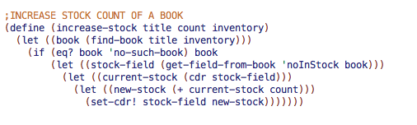
6. INCREASE-STOCK
CB.EN.U4CSE17065

Slide 16
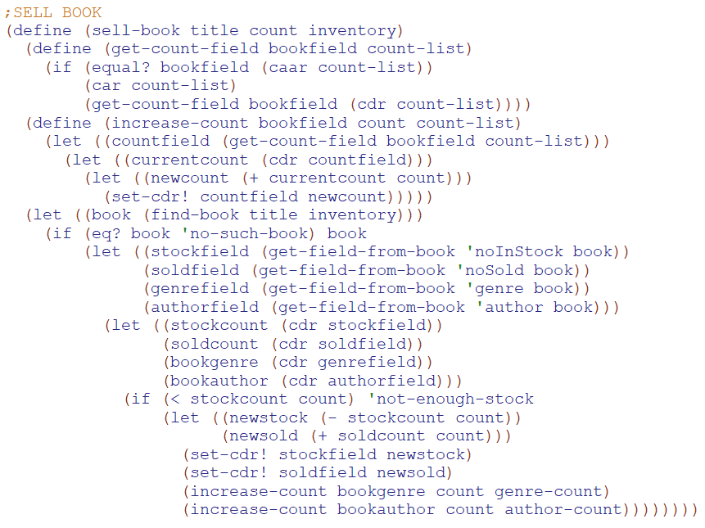
7. SELL-BOOK
CB.EN.U4CSE17065

Slide 17
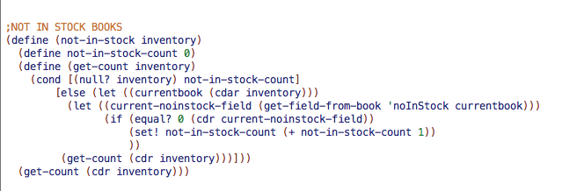
8. NOT-IN-STOCK BOOKS
CB.EN.U4CSE17049

Slide 18
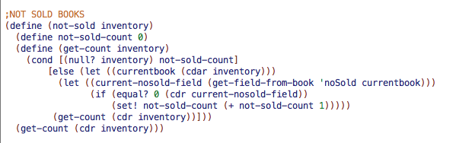
9. NOT-SOLD BOOKS
CB.EN.U4CSE17049

Slide 19
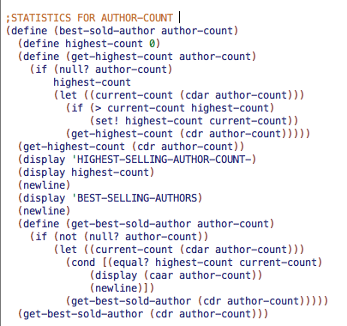
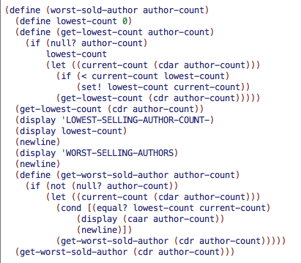
10. STATISTICS FOR AUTHOR COUNT
CB.EN.U4CSE17043

Slide 20
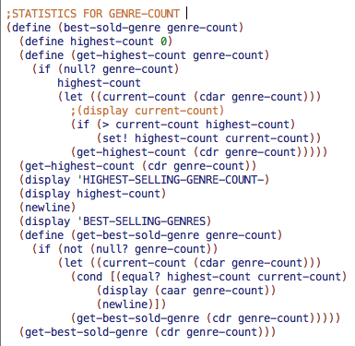
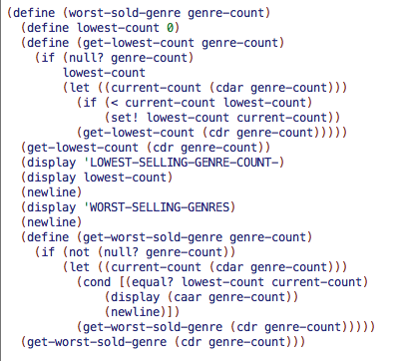
11. STATISTICS FOR GENRE-COUNT
CB.EN.U4CSE17014

